Slide 1


Store Performance Analysis
Detailed analysis of store performance data, highlighting key trends and challenges.
by Salman Faris

Slide 2
Store Performance Analysis
Significant performance variations across stores, with some consistently outperforming others.
Top Performers
Underperforming Stores
Performance Trends
Identify key factors contributing to success.
Analyze reasons for lower performance and develop strategies for improvement.
Track changes over time to identify emerging patterns.

Slide 3
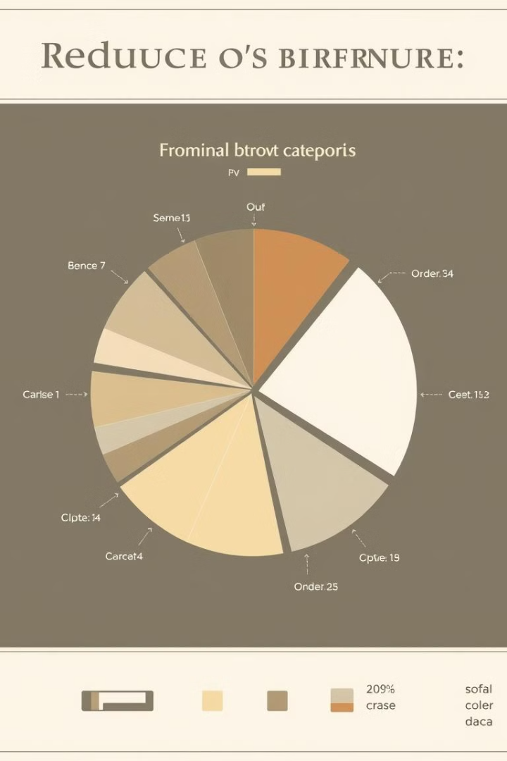
Product Category Impact on Revenue
Product categories have a significant impact on revenue, with some categories generating significantly more income than others.
Category
Revenue
Percentage
Electronics
$1,000,000
30%
Clothing
$800,000
24%
Home Goods
$600,000
18%
Food
$400,000
12%

Slide 4

Inventory Management Challenges
Inventory issues include frequent stockouts and overstocking, impacting sales and profitability.
Stockouts
Overstocking
Lost sales due to unavailable products.
Excess inventory ties up capital and increases storage costs.
Inventory Accuracy
Ensure accurate inventory data for effective management.

Slide 5
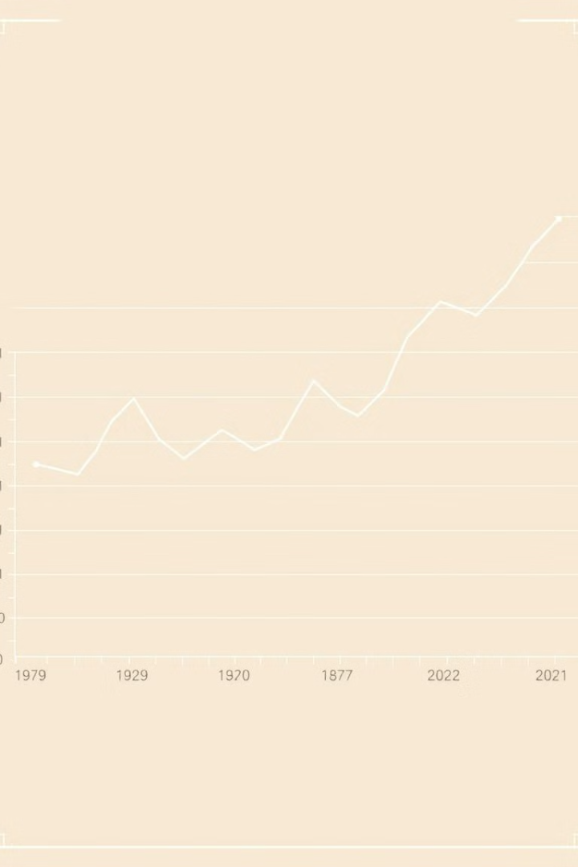
Seasonal Sales Trends
Clear seasonal sales trends are observed, with spikes during holiday seasons and dips during slower periods.
1
Peak Season
Holiday season, increased demand.
2
Shoulder Season
Moderate sales, preparation for peak season.
3
Off-Season
Lower demand, focus on inventory management.

Slide 6
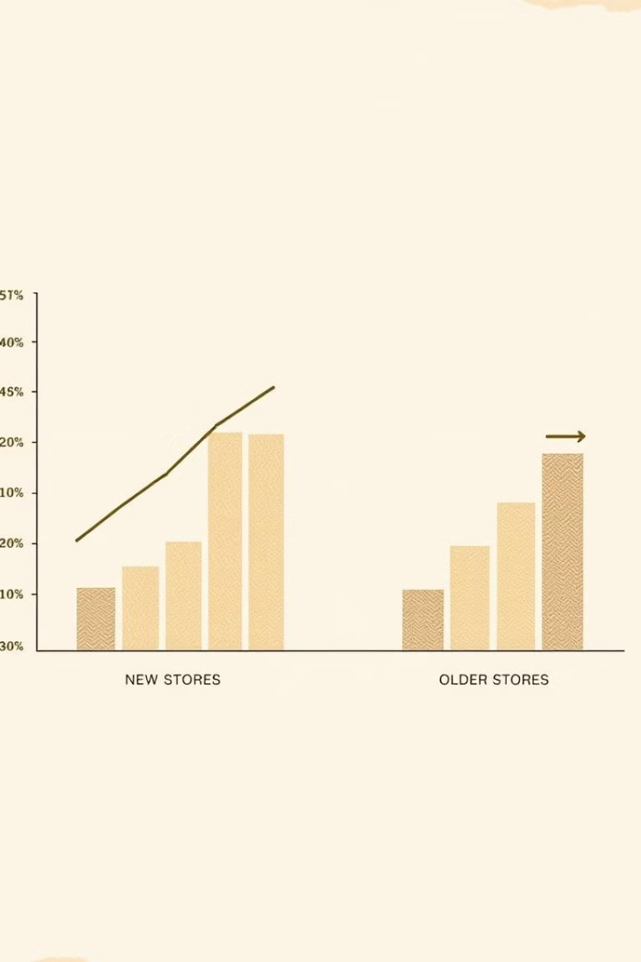
Newer vs. Older Store Performance
Newer stores generally perform differently from older stores, with newer stores showing a steeper upward trend in sales.
1
New Store Growth
2
Established Store Performance
Attracting new customers, building brand awareness.
Steady sales, focus on customer loyalty.
3
Performance Gap
Analyze differences to identify opportunities for improvement.

Slide 7
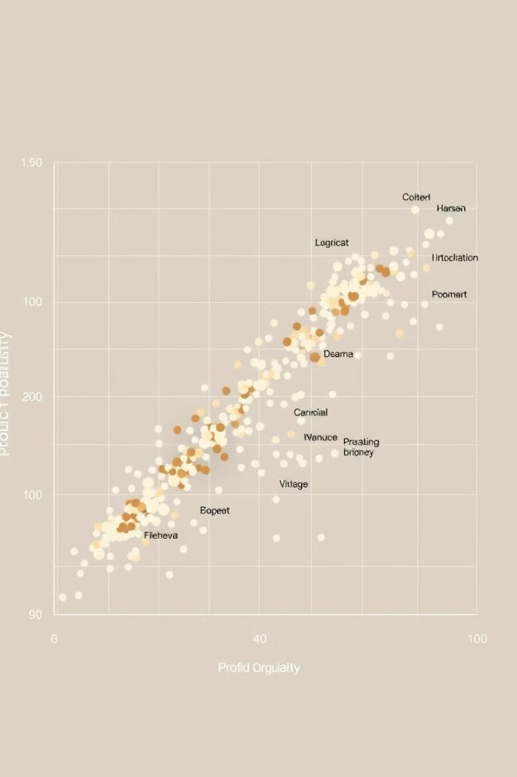



Profitability vs. Popularity
Popular products are not always the most profitable, indicating a need to optimize product mix.
High-Margin Products
Identify and promote products with high profit margins.
Low-Margin Products
Reassess the need for products with low profit margins.
Product Mix Optimization
Adjust product offerings to increase overall profitability.

Slide 8




Recommendations: Store Optimization
Optimize store layout, signage, and staffing to enhance customer experience and drive sales.
Improved Customer Flow
Ease of navigation, reduced wait times.
Strategic Signage
Clear product information, promotions.
Staff Training
Product knowledge, customer service.

Slide 9
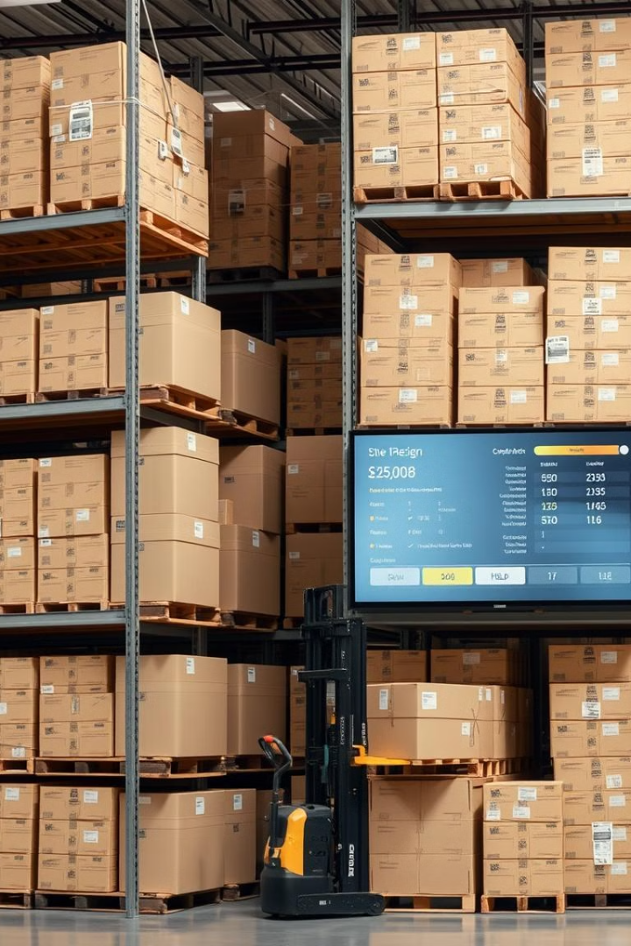
Recommendations: Inventory Management
Implement an effective inventory management system to minimize stockouts and overstocking.
Demand Forecasting
Real-Time Inventory Tracking
Accurate prediction of future demand.
Visibility of stock levels, automated alerts.
Optimized Ordering
Minimizing lead times, reducing costs.

Slide 10

Recommendations: High-Margin Product Promotion
Focus on promoting high-margin products to increase profitability.
1
Targeted Marketing
2
Product Bundling
3
Special Promotions
Reach customers interested in high-margin products.
Offer attractive packages to increase sales.
Incentivize purchases with discounts or offers.

